Slide 1

DATA ANALYSIS & MACHINE LEARNING
Crop Yield Prediction
Turning environmental and agricultural data into actionable yield forecasts
An end-to-end pipeline: Data → Cleaning → Analysis → Dashboard → ML → Web App
[IMAGE PLACEHOLDER: aerial view of agricultural field / farmland]
Notes:
Welcome the audience. Introduce the project as an end-to-end data science pipeline that predicts crop yield from environmental and agricultural inputs, built to support farmers and agricultural planners with data-driven decisions. Preview the six stages of the pipeline shown at the bottom of the slide.

Slide 2








ROADMAP
What We'll Cover
01
02
03
04
Objectives
Dataset
Data Cleaning
EDA
Problem statement & goals
Source, size & features
Preprocessing pipeline
Patterns & correlations
05
06
07
08
Dashboard
ML Models
Web App
Conclusion
Interactive visual exploration
Training & evaluation
Live prediction demo
Impact & future work
Crop Yield Prediction
2
Notes:
Walk through the eight sections of the presentation, from objectives through to conclusion. This gives the audience a map of the full pipeline before diving into details.

Slide 3

SECTION 01 — OVERVIEW
Project Objectives & Problem Statement
Predict crop yield from environmental and agricultural factors such as rainfall, temperature, and soil quality.
[IMAGE PLACEHOLDER:
farmer working in field]
Support decision-making give farmers and agricultural planners a data-driven basis for planning.
Build an end-to-end pipeline covering collection, cleaning, analysis, dashboarding, modeling, and deployment.
Crop Yield Prediction
3
Notes:
State the problem: agricultural yield depends on many interacting environmental and human-controlled factors. The project builds a full pipeline, from raw data to a deployed prediction tool, to give farmers and planners actionable, data-driven guidance.

Slide 4
SECTION 02 — DATASET
Dataset Overview & Source
An agricultural dataset combining climate, input-usage, and soil measurements collected across crops and seasons, with crop yield as the prediction target.
8
1
Mixed
Multi-
Season
Feature Columns
Target Variable
(Yield)
Numerical &
Categorical
Coverage
[IMAGE PLACEHOLDER: data sample screenshot] Raw records sourced from field observations and agricultural records; loaded as a structured table with one row per crop/season observation.
Crop Yield Prediction
4
Notes:
Describe the dataset at a glance: eight feature columns plus the yield target, mixed numerical and categorical types, spanning multiple crops and seasons. Point out that a raw data sample would be shown here as a screenshot.

Slide 5
SECTION 02 — DATASET
Data Dictionary & Features List
Feature | Type | Description
Rainfall | Numerical | Total rainfall recorded for the growing period (mm)
Temperature | Numerical | Average temperature during the growing period (°C)
Pesticide Usage | Numerical | Quantity of pesticide applied (kg/ha)
Fertilizer Usage | Numerical | Quantity of fertilizer applied (kg/ha)
Soil Quality | Categorical / Numerical | Soil quality index or classification
Crop Type | Categorical | Crop grown (e.g. wheat, rice, maize)
Season | Categorical | Growing season (e.g. Kharif, Rabi, Summer)
Yield (Target) | Numerical | Crop yield achieved — the variable being predicted
Crop Yield Prediction
5
Notes:
Walk through the eight input features plus the yield target. Highlight the mix of numerical measurements (rainfall, temperature, input usage) and categorical fields (crop type, season, soil quality) that the model needs to handle.

Slide 6





SECTION 03 — PREPROCESSING
Data Cleaning & Preprocessing Pipeline
[IMAGE PLACEHOLDER: cleaning steps diagram]
1
2
3
4
5
Missing Values
Duplicates &
Outliers
Encode
Categoricals
Scale &
Normalize
Train / Test
Split
Impute or remove, with justification
Detect and remove
One-hot / label encoding
Standardize numerical ranges
Partition for evaluation
Crop Yield Prediction
6
Notes:
Explain the five-stage cleaning pipeline in order: handling missing values, removing duplicates and outliers, encoding categorical variables, scaling numerical features, and finally splitting into training and testing sets.

Slide 7
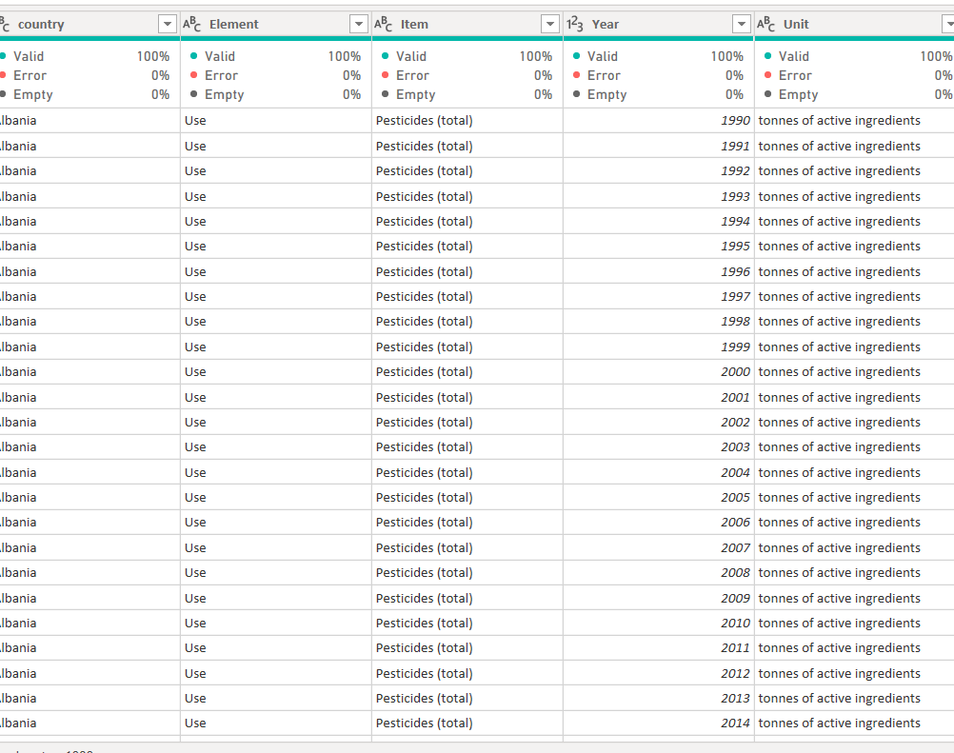
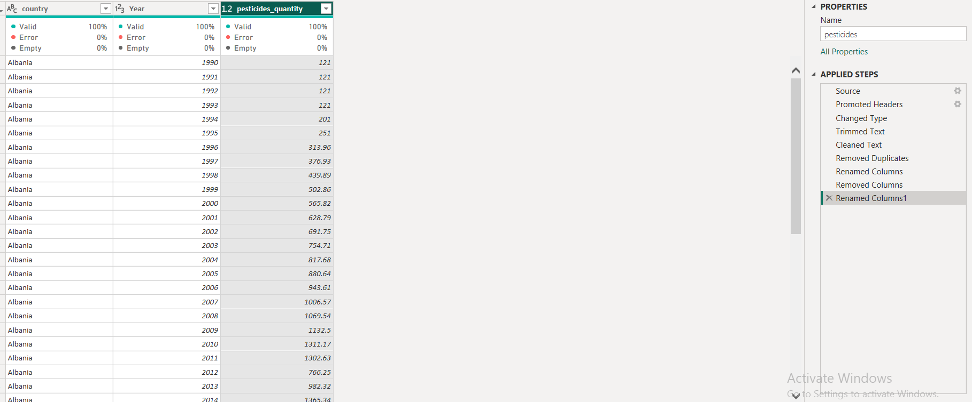
Pesticides data

Slide 8
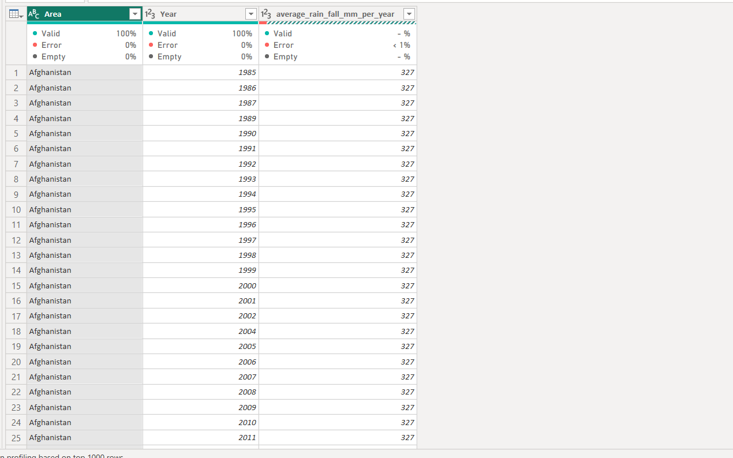
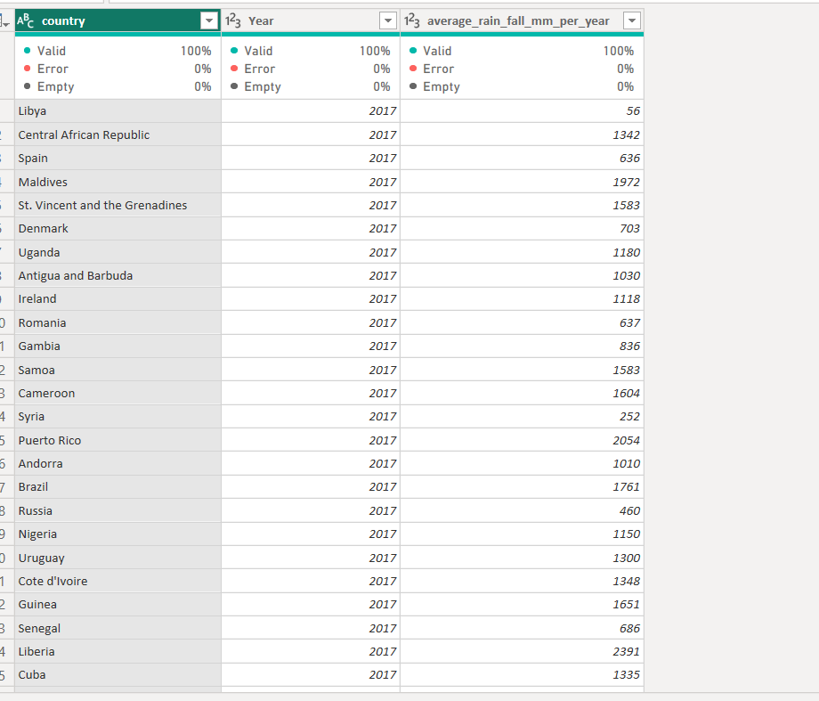
Rainfall data

Slide 9
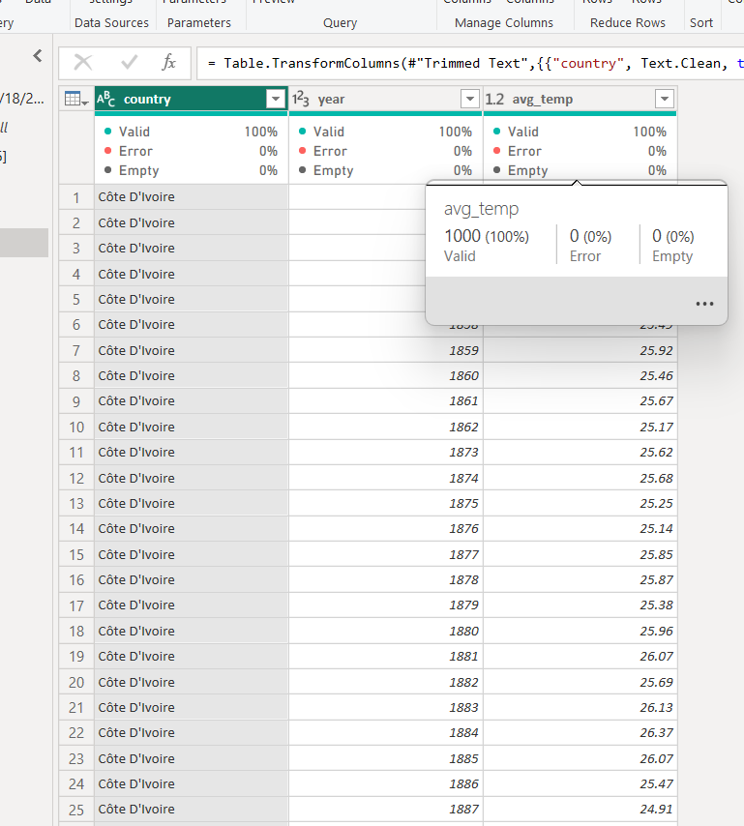
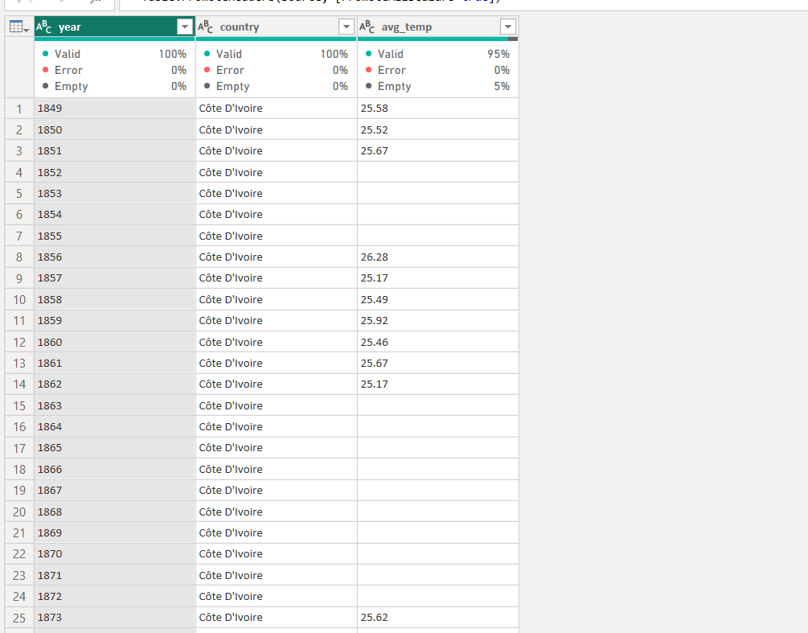
Temp data

Slide 10
SECTION 03 — PREPROCESSING
Missing Values: Detection & Handling
BEFORE
AFTER
[IMAGE PLACEHOLDER: data quality — before]
[IMAGE PLACEHOLDER: data quality — after]
Rainfall
4.2% missing
Rainfall
0.0% missing
Soil Quality
7.8% missing
Soil Quality
0.0% missing
Pesticide Usage
2.1% missing
Pesticide Usage
0.0% missing
Fertilizer Usage
1.4% missing
Fertilizer Usage
0.0% missing
Strategy: median imputation for skewed numerical fields, mode imputation for categorical fields; rows missing the yield target are dropped.
Result: a complete, model-ready dataset with no null values remaining, imputations justified by feature distribution.
Crop Yield Prediction
7
Notes:
Show the before/after picture of data quality. Explain the justification for each imputation choice: median for skewed numeric fields to avoid outlier distortion, mode for categoricals, and dropping any row missing the target variable.

Slide 11
SECTION 04 — EXPLORATORY DATA ANALYSIS
Statistical Summary of Features
[IMAGE PLACEHOLDER: summary statistics table]
Feature | Mean | Std Dev | Min | Max
Rainfall (mm) | 842.3 | 215.6 | 210.0 | 1580.0
Temperature (°C) | 26.4 | 4.8 | 12.1 | 39.5
Pesticide (kg/ha) | 3.1 | 1.4 | 0.0 | 9.8
Fertilizer (kg/ha) | 112.7 | 38.2 | 10.0 | 265.0
Yield (t/ha) | 4.6 | 1.7 | 0.5 | 9.4
5
Numerical
Features
3
Categorical
Features
Crop Yield Prediction
8
Notes:
Present the descriptive statistics for the key numerical features: rainfall, temperature, pesticide and fertilizer usage, and yield itself. Note the wide range in rainfall and yield, which motivates deeper distribution analysis next.

Slide 12
SECTION 04 — EXPLORATORY DATA ANALYSIS
Distribution Analysis
[IMAGE PLACEHOLDER: histograms / boxplots]
9
Notes:
Show the distribution shapes of two key drivers. Rainfall is right-skewed with most observations between 600 and 1000mm; temperature is roughly bell-shaped, centered around 24-30 degrees Celsius, matching typical growing-season conditions.

Slide 13
SECTION 04 — EXPLORATORY DATA ANALYSIS
Correlation Analysis
[IMAGE PLACEHOLDER: correlation heatmap]
Rainfall
Temp
Pesticide
Fertilizer
Yield
Rainfall
1.00
-0.18
0.05
0.22
0.61
Temp
-0.18
1.00
0.10
-0.05
-0.34
Pesticide
0.05
0.10
1.00
0.31
-0.22
Fertilizer
0.22
-0.05
0.31
1.00
0.48
Yield
0.61
-0.34
-0.22
0.48
1.00
Key read: Rainfall (+0.61) and fertilizer usage (+0.48) correlate most strongly with yield; temperature shows a moderate negative relationship (–0.34).
10
Notes:
Walk through the correlation matrix. Rainfall and fertilizer usage have the strongest positive relationships with yield, while higher temperatures are associated with lower yield, likely reflecting heat stress on crops.

Slide 14

SECTION 04 — EXPLORATORY DATA ANALYSIS
Average Yield by Crop Type
[IMAGE PLACEHOLDER: bar chart comparison]
Sugarcane leads
at 7.9 t/ha on average, followed by maize and rice. Cotton shows the lowest average yield in this sample, consistent with its lower water and nutrient responsiveness.
11
Notes:
Compare average yield across the six crop types in the dataset. Sugarcane and maize show the highest average yields, while cotton and soybean trail behind — a pattern the model should learn to reflect through the crop-type feature.

Slide 15
SECTION 04 — EXPLORATORY DATA ANALYSIS
Yield by Season & Region
[IMAGE PLACEHOLDER: grouped charts]
12
Notes:
Break yield down by season and region. The Kharif (monsoon) season consistently outperforms Rabi and Summer across all four regions, with the South region showing the highest yields in every season.

Slide 16



SECTION 04 — EXPLORATORY DATA ANALYSIS
Key Insights from EDA
[IMAGE PLACEHOLDER: insight highlights]
Rainfall is the strongest single driver with a +0.61 correlation to yield — far ahead of any other feature.
Heat stress reduces yield temperatures above 32°C are associated with a consistent yield drop across crops.
Crop type matters as much as conditions sugarcane and maize outperform cotton and soybean under similar inputs.
Season timing amplifies other effects Kharif-season yields exceed Rabi and Summer across every region studied.
13
Notes:
Summarize the four headline findings from exploratory analysis: rainfall dominance, the negative effect of heat stress, meaningful differences between crop types, and the amplifying effect of season timing.

Slide 17
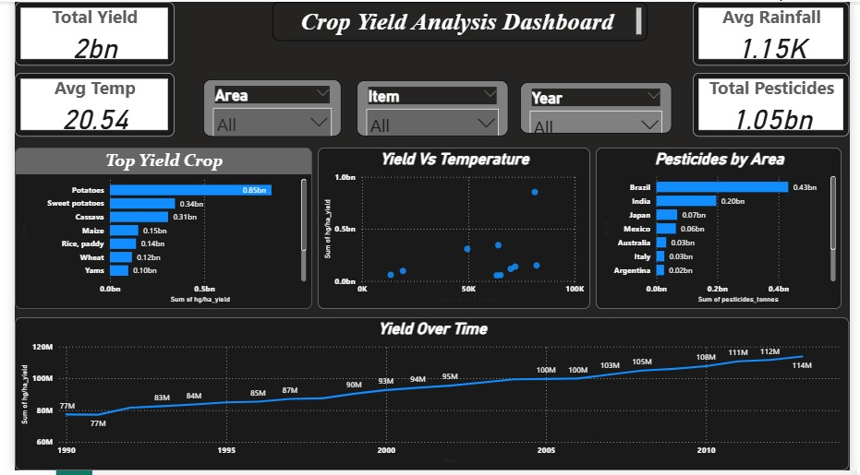
SECTION 05 — DASHBOARD
Interactive Dashboard Overview
[IMAGE PLACEHOLDER: dashboard main screen]
Yield Trends by Region
Correlation Heatmap
Feature Importance
Rainfall
Fertilizer
Crop Type
Temp
Crop Yield Prediction
14
Notes:
Show the interactive dashboard mockup: a yield-trends line chart on the left, and a correlation heatmap plus feature-importance panel on the right. This is the exploratory front-end analysts and planners use to explore the data themselves.

Slide 18


SECTION 05 — DASHBOARD
Dashboard Interactions & Filters
[IMAGE PLACEHOLDER: dashboard demo]
Dynamic Filters — Filter by crop, season, and region to isolate any subset of interest.
Drill-down Charts — Click any bar or region to reveal underlying record-level detail.
Live Recalculation — Summary statistics and charts update instantly as filters change.
Exportable Views — Export any filtered view or chart for reporting and further analysis.
15
Notes:
Highlight what makes the dashboard interactive: filtering by crop/season/region, drilling into individual records, live recalculation of summary statistics, and the ability to export any filtered view.

Slide 19

SECTION 06 — MACHINE LEARNING
Model Overview & Comparison
[IMAGE PLACEHOLDER: model comparison table]
Model | R² | MAE | MSE | RMSE
Linear Regression | 0.71 | 0.62 | 0.71 | 0.84
Decision Tree | 0.79 | 0.51 | 0.55 | 0.74
Random Forest | 0.89 | 0.34 | 0.29 | 0.54
Gradient Boosting | 0.87 | 0.37 | 0.32 | 0.57
Random Forest wins
Highest R² (0.89) with the lowest error across MAE, MSE, and RMSE.
All models trained on the same 80/20 train-test split with identical preprocessing, then evaluated on held-out test data for a fair comparison.
16
Notes:
Compare four regression models on the same held-out test set. Random Forest achieves the best R² and lowest error metrics across the board, making it the selected model for deployment.

Slide 20
SECTION 06 — MACHINE LEARNING
Best Model: Random Forest Regressor
[IMAGE PLACEHOLDER: evaluation metrics charts]
0.89
0.34
0.29
0.54
R² Score
MAE
MSE
RMSE
Variance explained
Mean Absolute Error (t/ha)
Mean Squared Error
Root Mean Sq. Error (t/ha)
Trained and validated on a held-out 20% test set — metrics reflect true out-of-sample performance, not training fit.
17
Notes:
Drill into the winning model’s test-set metrics: an R² of 0.89 means the model explains 89% of the variance in yield, with a mean absolute error of just 0.34 tonnes per hectare.

Slide 21
SECTION 06 — MACHINE LEARNING
Feature Importance Analysis
[IMAGE PLACEHOLDER: feature importance bar chart]
18
Notes:
Rank the features by importance from the Random Forest model. Rainfall dominates at 29%, followed by fertilizer usage and pesticide usage — confirming the correlation analysis from earlier and giving farmers a clear priority order for the factors within their control.

Slide 22



SECTION 07 — BONUS
Streamlit Web App: Live Prediction
[IMAGE PLACEHOLDER: app screenshot]
Crop Yield Predictor
User Inputs Farmers enter rainfall, temperature, fertilizer/pesticide use, crop type, and season.
Rainfall (mm)
850
Model Inference The trained Random Forest model runs instantly in the background.
Temperature (°C)
27
Fertilizer (kg/ha)
120
Instant Prediction Expected yield is displayed immediately, in tonnes per hectare.
Crop Type
Maize
Predict Yield
Production-Ready Deployed as a lightweight, shareable Streamlit application.
Predicted Yield
6.1 t/ha
19
Notes:
Demo the bonus deliverable: a Streamlit web app where a user enters environmental and agricultural parameters and receives an instant predicted yield, powered by the trained Random Forest model, ready for production deployment.

Slide 23
CONCLUSION & FUTURE WORK
From Data to Decisions
[IMAGE PLACEHOLDER: future roadmap]
KEY FINDINGS & IMPACT
FUTURE WORK
Rainfall and fertilizer usage are the strongest levers on yield.
Expand feature set with satellite imagery & soil sensors
Random Forest predicts yield with R² = 0.89 on unseen data.
Explore deep learning models for higher accuracy
The Streamlit app puts predictions directly in farmers’ hands.
Integrate real-time weather and IoT data streams
Thank you
20
Notes:
Close with the headline findings and business impact: better-informed planting and input decisions for farmers. Preview the roadmap — richer features like satellite imagery, deep learning experiments, and real-time data integration — then thank the audience.

